Slide 1


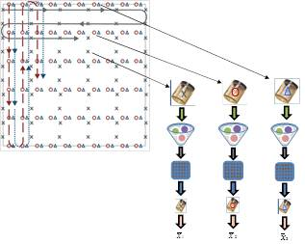
Office of Communications
Anclote Key, FL
Incremental Sampling Case Study (ISM)
March 2013
Notes:
Actual sampling took place on January 22 – 23, 2013

Slide 2
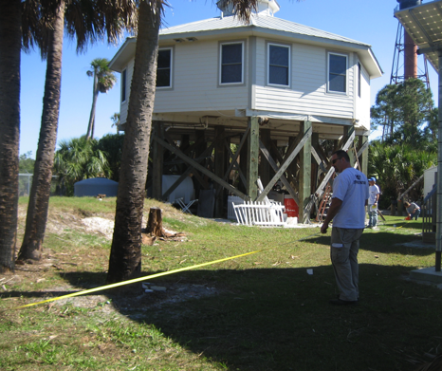
Soil Sampling Data –
What Do We All Need?
Accuracy
Reproducibility
Defensibility
….but how do we get it?
Incremental Sampling Methodology (ISM)
…..may be your answer…..
Notes:
We were asked to investigate this site because during a risk evaluation we made comments to the district that the assessment needed to go into the area of Park Ranger’s yard since contamination was shown to extend there
During the development of our ISM Guidance I learned of the importance of planning so the Site Investigation project leader the UF and myself teleconferenced and start by stepping through the systematic planning process to develop a CSM, crystalize our thinking about what the study question is, set up our decision units, and decision criteria and so forth .
But regardless of whether we are investigating this as a “recognized environmental concern” in the vernacular of Phase I ESA, or a potential “source area” under CERCLA, or even doing an exposure assessment to see if the site poses a risk to someone living next door, we’re going to want accurate, reproducible data so that we can make a defensible environmental decision. If the sampling goal involves estimating mean concentrations in soil, we believe ISM can be one of the best tools available for accomplishing this.

Slide 3
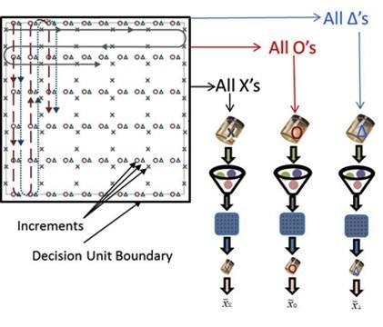
Sampling Designs
(Discrete vs. ISM)
Discrete
ISM
Notes:
Here is our diagram of ISM you may recognized from Part 1. This is also the first image you see when you go to the ITRC web page for our guidance document. We hope it summarizes succinctly the main steps involved in collecting and processing an ISM sample.
Even though we’ve discussed this diagram before in Part, 1, but I will just review the components again briefly here to make sure we are all on the same page.
The box represents a DU – a volume of soil about which we need to make some decision. The symbols inside represent increments of soil that are collected. The lines and arrows indicate a possible travel path a sample collector might physically take as she moves through the DU collecting increments. Here, we are showing three field replicate ISM samples – so the 60 triangle increments all go into a jar, all the 60 circles into another and all the 60 x’s into a third. The three ISM samples are processed and subsampled incrementally in the laboratory to obtain an analytical subsample which is then analyzed.
We learned the value of collecting replicate ISM in Part 1 – it gives you a measure of overall sampling and analytical precision, and that allows you to calculate a 95% UCL should that be of interest.

Slide 4
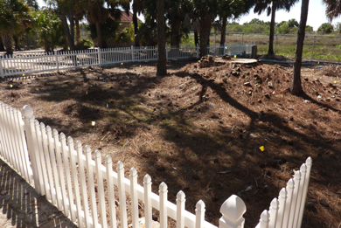
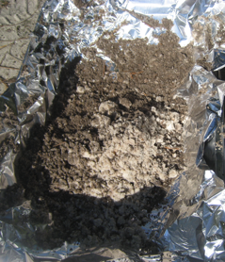

ISM Goal – A Representative Sample!
The goal of ISM is to provide a mean analyte concentration representative of the smallest volume of soil for which a decision needs to be made.
Representative subsampling
Notes:
The most accurate way to measure a mean is to conduct a census – that is to count every member of a population. Translated to our sampling problem, that would mean collecting the entire DU into a jar and analyzing it in the lab. Obviously this is ridiculous; so we’re going to have to base our estimate of the mean on a sample that is much smaller than the DU.
Ideally, that sample would represent the DU.
This is a pretty daunting challenge when you think about it; we’re making a decision about a volume of soil typically measured on the scale of cubic yards by collecting a sample in 6-8 oz jar which is sent to a lab where an actual measurement is made on just a few grams.
Fortunately, ISM has been designed to meet this challenge; that is to obtain a sample that has constituents in the same proportions as they are in the DU.

Slide 5
Characteristics of ISM
Based on sampling theory of Pierre Gy
Systematic Planning
Specific field sampling methods
Specific laboratory methods (sample prep and sub-sampling techniques)
Sample homogenization is key

Slide 6


Principles, Systematic Planning, and Statistical Design
Plan
Principles
Systematic Planning
Statistical Design
Reduce Sampling Errors
  Heterogeneity Rules!
Plan, Plan, Plan
  Involve the entire team
  Know your site
  Know your objectives
  Focus your decisions
Design for Confidence
  The mean is the goal!
  Collect replicates to calculate UCL
Notes:
When you took the ITRC ISM training we learned some of the basic principles of soil sampling; specifically the importance of heterogeneity operating at different spatial scales and how to successfully do soil sampling in the face of this heterogeneity. One of the key concepts Deana talked about there was adequate sample support. We saw how we can increase sample support by collecting more increments of soil across a DU or in the case of subsampling in the lab, collecting more aliquots from the jar of soil for analysis.
In the module on systematic planning – we learned about the importance of involving all stakeholders early on in the project, developing a CSM, and establishing clear sampling objectives. But we put particular emphasis on how to select decision units since that is such a critical component of ISM and might be a slightly different way we conventionally think about sites.
Phil Goodrum wrapped up Part 1 with an overview of the statistical foundation for ISM. We learned why ISM provides a reasonable estimate of the mean, what constitutes a good ISM sampling design, & how a upper confidence limits can be calculated from ISM field replicate data.

Slide 7
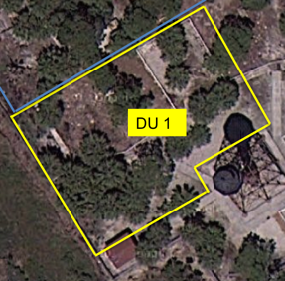
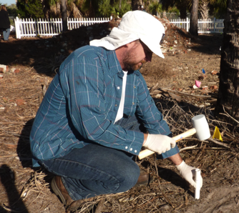
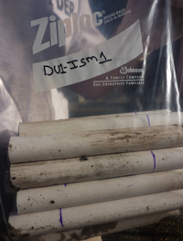
Systematic Planning
Sample Collection Components
Decision Unit (DU) / Sampling Design
  Simple random sampling
  Random sampling within a grid
  Systematic random sampling
Sampling tools
  Core shaped
  Adequate diameter
Mass
  Increment mass
  Sample mass
ITRC, ISM-1, Section 4.3.4.2
Notes:
Speaker Bullets
Sampling Design - 3 basic sampling designs
The appropriate sample support for tools to address soil sampling theory to limit error
Adequate mass collected to limit error
Supplemental Information
Section 4.3.4.2 Effects of sampling pattern

Slide 8
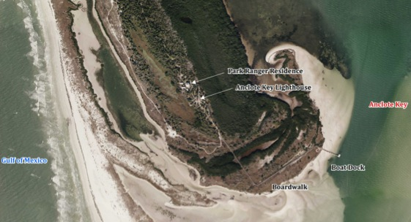
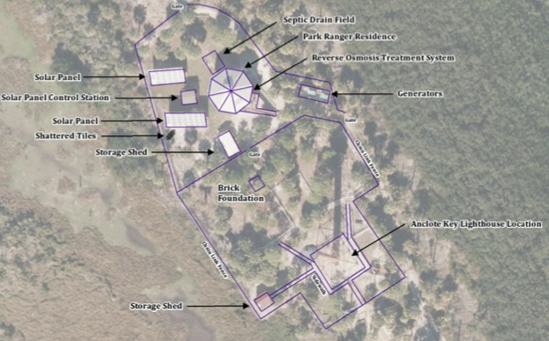

Site: Anclote Key Lighthouse
Location Map
Anclote Key, Pinellas County, FL

Slide 9
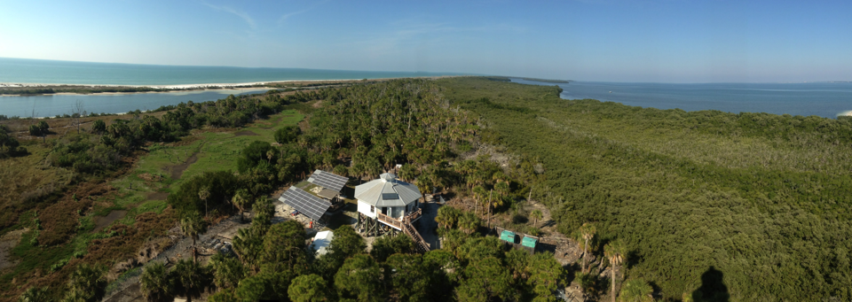

Site History
Lighthouse decommissioned as navigation light in 1985; part of Anclote Key Preserve State Park
Cast-iron Light house painted with lead paint
Historical use of aid to navigation (ATON) batteries containing mercury and maybe lead
Discrete sampling identified Lead and Mercury as COPCs

Slide 10
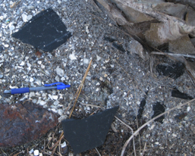
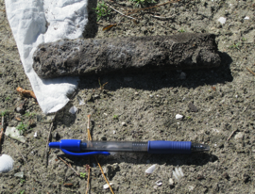
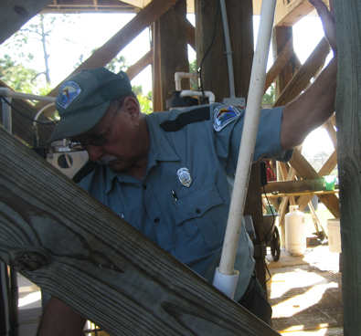
Planning: Conceptual Site Model
COPCs:
Lead and Mercury
Source:
ATON batteries and lead based paint
Receptors or concern:
current and future residents (Park Ranger’s residence)
park visitors

Slide 11
Planning: Sapling Objectives
Use ISM to obtain a reliable estimate of the grand mean lead concentration in the soil within each DU.
Use ISM to obtain the 95% UCL for mercury concentration in the soil within each DU.
Obtain discrete samples from each DU and calculate the mean (lead concentration) and 95% UCL (mercury concentration) for comparison with the ISM data.

Slide 12
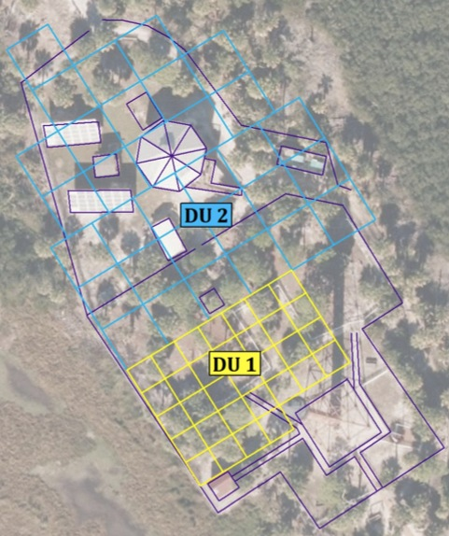

Planning: DU Identification
DU designation based on historical data
N
DU 1
Located Northwest of the Lighthouse
Approximately 0.18 acre
DU 2
Area surrounding the Park Ranger’s residence
Approximately 0.5 acre
Notes:
In DU1 the objective was to determine magnitude and extent of contamination since this was a quadrant in the park that has hardly been sampled

Slide 13
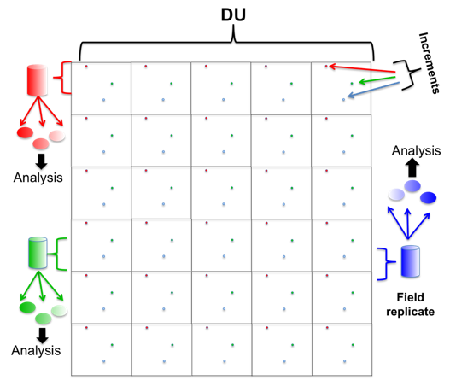
Planning: General Sampling Plan
Increments collected using systematic random sampling design
Three replicate sets collected from each DU for statistical evaluations
Sampling depth for ISM: 0-6 inches
Obtain one discrete sample from each DU cell for comparison with the ISM data
ITRC, ISM-1, Section 5.3.5
Notes:
Speaker Bullets
Recommended to evaluate spatial heterogeneity and ensure reliable estimate of the mean
Required for any statistical evaluation, e.g. 95% UCL of the mean
Refer to Day 1 training presentation of ISM replicates, estimation of mean and coverage
Refer to Chapter 4 of the ISM document for the statistical basis/evaluation of ISM replicates
Supplemental Information
ITRC, ISM-1, Section 5.3.5

Slide 14
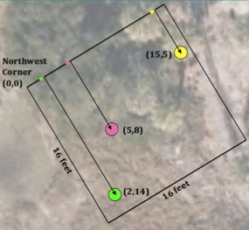
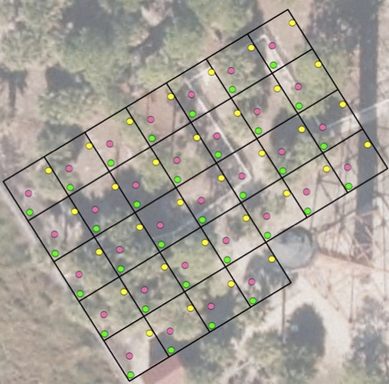
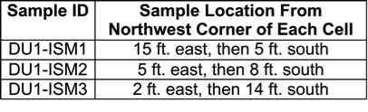
Planning: DU1 ISM Sampling Plan
DU1 ISM Coordinates and increment collection path
DU1 increments = 32
DU1 replicates = 3
DU1 ISM1
DU1 ISM2
DU1 ISM3
N
Notes:
DU1 Northwest quadrant of the park
Increment locations represent predetermined coordinates

Slide 15
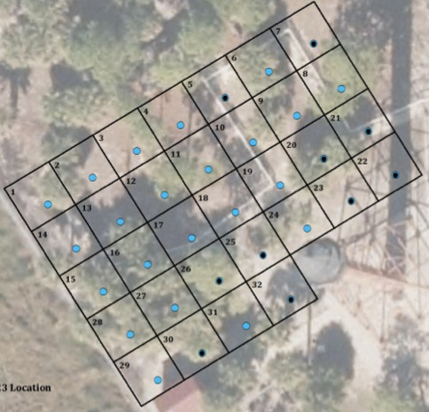
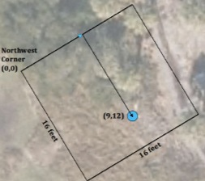
Planning: DU1 Discrete Sampling
DU1 Discrete sampling collection path
Discrete Samples = 32
Surface (0-6in) discrete sample location
Surface (0-6in) and subsurface (6-24in)
discrete sample locations
N
Notes:
Location of discrete samples at the 0 – 6: interval locations generated with random # generator

Slide 16
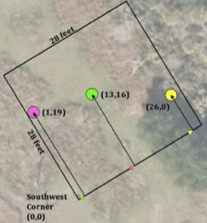
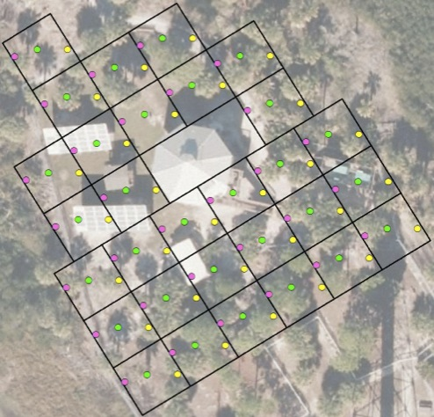
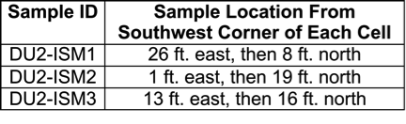
Planning: DU2 ISM Sampling Plan
DU2 ISM Coordinates and increment collection path
DU1 increments = 30
DU1 replicates = 3
DU2 ISM1
DU2 ISM2
DU2 ISM3
N

Slide 17
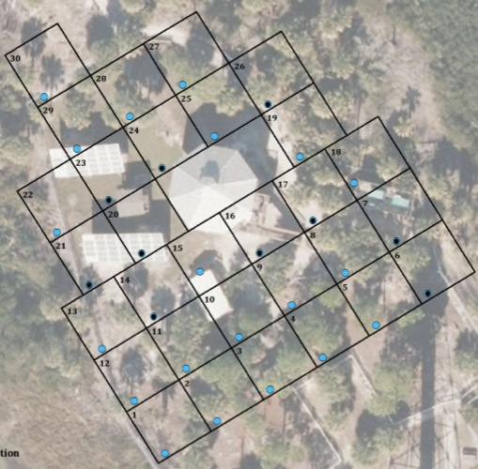
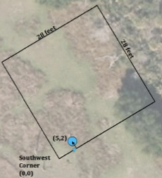
Planning: DU2 Discrete Sampling
DU2 Discrete sampling collection path
Discrete Samples = 30
Surface (0-6in) discrete sample location
Surface (0-6in) and subsurface (6-24in)
discrete sample locations
N

Slide 18
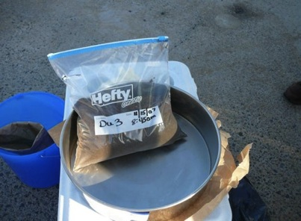
Planning: ISM Increment Mass
Criteria – mass (non-volatile)
  Target sample mass of 1.5 Kg
  Target increment mass of 50 g
M_{s} = ρ • n • D_{s} • π • (q / 2)²
M_{s} – targeted mass of sample (g)
D_{s} – increment length (cm)
n – number of increments
ρ - soil or sediment density (g/cm³)
q - diameter of sample core (cm)
ITRC, ISM-1, Section 5.3.1
Notes:
Speaker Bullets
All parameters should be determined during systematic planning
Generally, a minimum of 30 increments should be collected for each DU
Supplemental Information
ITRC, ISM-1, Section 5.3.1
Example of bulk ISM sample ~2 kg

Slide 19
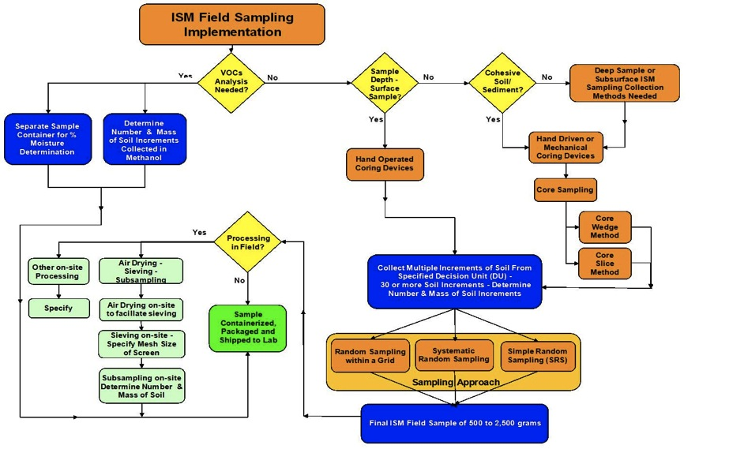
ISM Field Sampling Implementation
ITRC, ISM-1, Section 5.1, Figure 5-1
Notes:
Speaker Bullets
Figure 5-1 from the technical regulatory document shown as an example only. The audience is not expected to read this flowchart (small font); provided only as an example to illustrate the multiple decisions that will need to be made and implemented.
Multiple step process that all should be discussed/planned for during systematic planning
Technical regulatory document will assist with these steps
Supplemental Information
ITRC, ISM-1, Section 5.1, Figure 5-1

Slide 20
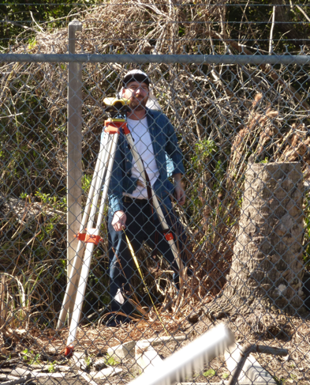
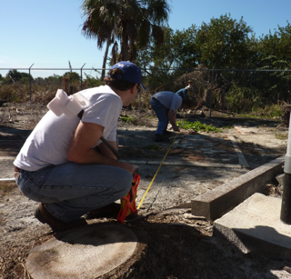
Field Sampling : DU Identification
Identify DU in the field
  Use typical environmental site
  investigation procedures
  Examples
    Survey
    GPS
    Swing ties
ITRC, ISM-1, Section 9.3 & Appendix C, Section C.3
Notes:
Speaker Bullets
DU(s) determined during systematic planning
Standard environmental site investigation procedures employed to delineate DU in the field
The photograph is from the Florida case study that was introduced as you recall during the ISM Day 1 training. Former golf course with arsenic as the contaminant of concern. The DU is a ¼ acre residential lot – assumed exposure area of potential future residential development.
Chapter 9, Section 9.3 and Appendix C, Section C.3 for Former Golf Course Field Demonstration of ISM
Supplemental Information
ITRC, ISM-1, Section 9.3 & Appendix C, Section C.3for Former Golf Course Field Demonstration of ISM

Slide 21
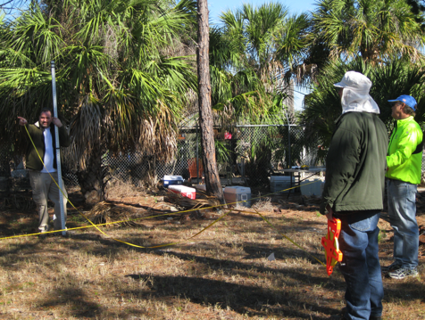
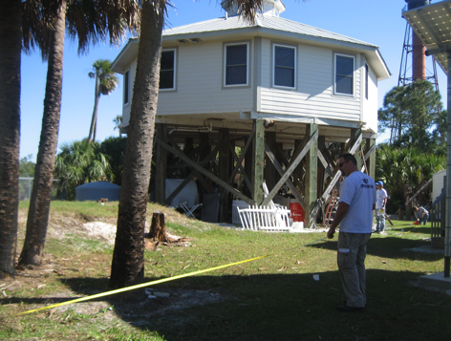
Field Sampling: DU Identification
DU1
DU2

Slide 22
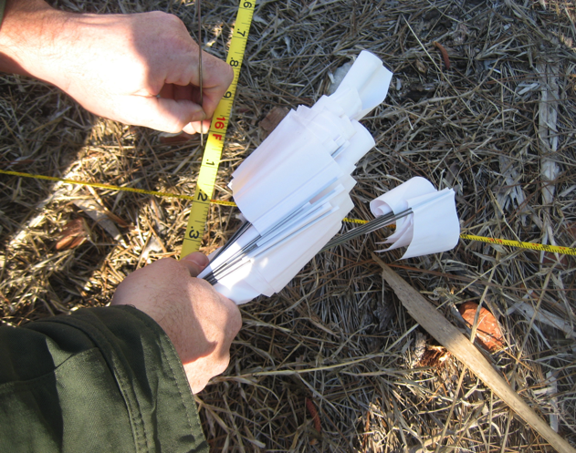
Field Sampling: DU Identification
DU boundaries were demarcated by white flags

Slide 23
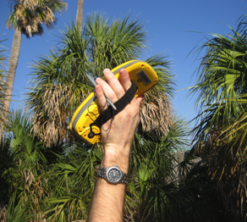
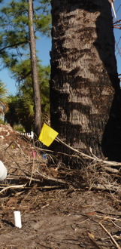

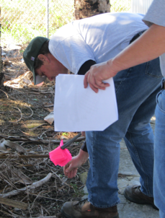

Field Sampling: Increment Locations
Identify increment locations in field
  Utilize similar site investigation tools
  Increment location demarcated by :
    Yellow; Pink and Green
  Discrete sample locations: blue
Notes:
Speaker Bullets
Sampling design, number of increments, increment locations are determined during systematic planning (Day 1 training)
Typically 30 or more increments per DU
Similar tools are utilized to identify increment locations; e.g. survey grid, GPS, sampling flags
Example of transformer pad and residential backyard DUs
Increment locations are flagged in these examples. May assist inexperienced ISM practitioners, more experienced ISM samplers it may not be necessary.
Supplemental Information
ITRC, ISM-1, Section 5.3.1

Slide 24
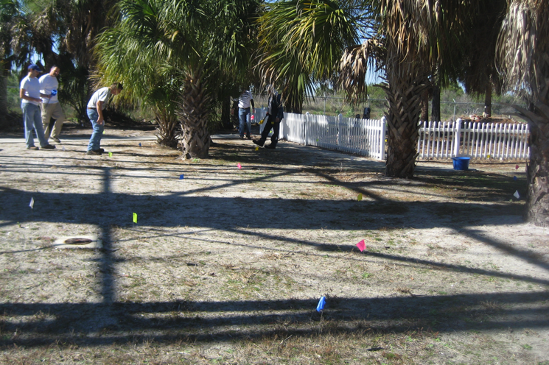
Field Sampling: Increment Locations

Slide 25
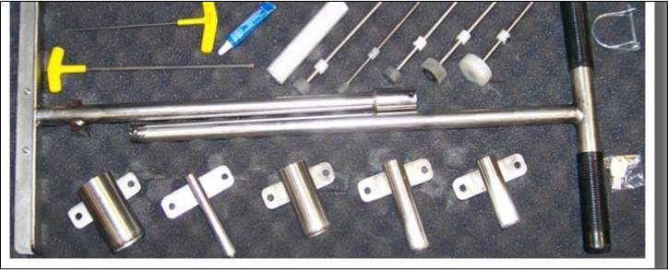

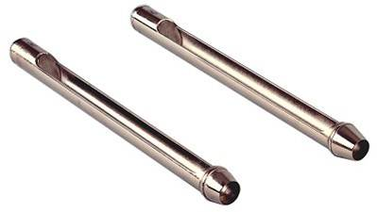
Field Sampling: Tools
Soft Surface Soil
Source: Courtesy http://www.jmcsoil.com/index.html
http://fieldenvironmental.com/evc-incremental-sampler.php
Notes:
Speaker Bullets
Examples of commercially available tools.
Other tools, e.g. agricultural soil samplers, may also be applicable to ISM.
Top: EVC Incremental Sampler (kit); Bottom: JMC Backsaver Handle and Soil Tubes

Slide 26

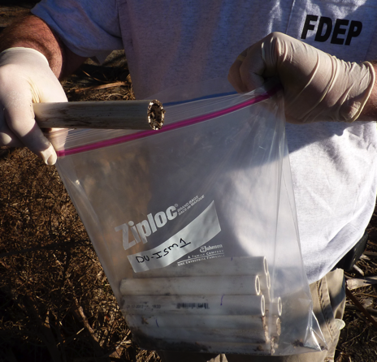
Field Sampling
Notes:
Speaker Bullets
Florida Anclote Key Example – Every job needs at least one supervisor.
Surface core increments collected in plastic 5 gallon bucket

Slide 27
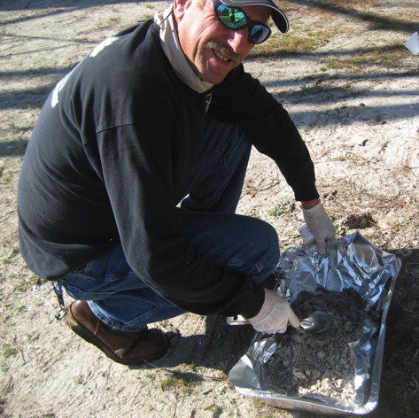
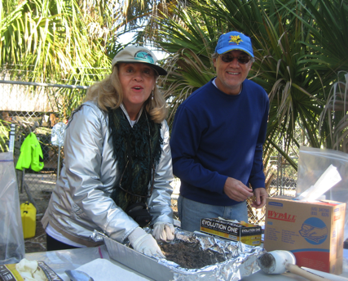
Field Sampling

Slide 28
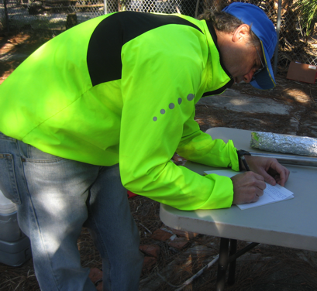
Field Sampling: Documentation
Field activity log maintained while samples are being taken and include detailed records of sampling events
Sample containers should include: year, month and day of sample collection

Slide 29

Lab Processing: Include planning
Lab
ITRC, ISM-1, Section 6.1.1
Notes:
Speaker bullets
Project planning, include lab processing
Narrative
Include the lab processing options in the initial project planning discussions. Please don’t assume that just feeding the lab dirt samples will automatically produce good data.
Supplemental information
See Section 6.1.1

Slide 30


Lab Processing: Verify Laboratory Certification
National Environmental Laboratory
Accreditation Program
(NELAP)
Non-NELAP state accreditation
Agency-specific accreditation
  DoD Environmental Laboratory Approval Program
ITRC, ISM-1, Section 6.4.1
Notes:
Speaker bullets
Certification options from these
NELAP
State
Agency (e.g. DoD)
Narrative
Lab certification is available through the usual avenues; the National Environmental Laboratory Accreditation Program run by the NELAC Institute, non-NELAP states and agency specific accreditation such as the DoD Environmental Laboratory Approval Program.
.
Supplemental information
See Section 6.4.1

Slide 31
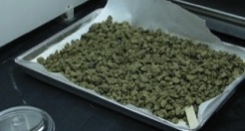
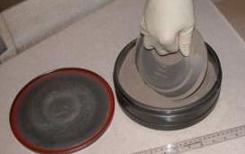
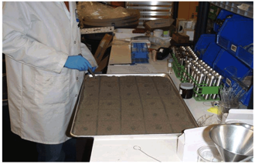

Lab Processing: ISM general procedures
Remove vegetation and large agglomerates
Sieve to refine sample
Air drying
  Goal: crushable agglomerates
Grind or mill sample
  Goal: homogenize sample
  Complete particle size reduction of all soil components including hard crystalline materials to a defined maximum particle size (e.g. < 75 µm
Slab cake for laboratory sub-samples
  Spread sample onto tray
  divide into into grid,
  sample increments in the same manner as in the field.
Picture from USACE-Alan Hewitt
ITRC, ISM-1, Section 6.2.2.3
Notes:
Speaker bullets
Air dry
Ventilation
Low boiling – volatilization losses
Binding to particles
Loss risk table
Other conditioning options available when air drying not appropriate
Narrative
The most common sample conditioning step is air drying, usually at room temperature in a ventilation hood. The goal is to produce dry crushable dirt clods that work well with the mechanical processes that can follow. Air drying can produce low recovery of analytes with lower boiling points that are not strongly bound to the soil particles. The guidance has a loss risk table that summarizes the relative risk of loosing various semivolatile organics and energetics during air drying. For example, the risk of loosing naphthalene is large, acenaphthene is moderate and benzo[a]pyrene is small. Diesel and mercury have a wide variety of components or species with a range of volatilities. If lower boiling analytes are of primary interest, it might be necessary to avoid air drying.
When working with surface soils that have been exposed to air for many months or years after the potential contaminant release, the likelihood of volatilizing additional contaminants is small.
Supplemental information
See Section 6.2.2.3

Slide 32
Lab Processing: Anclote Key
Remove vegetation and large agglomerates
No Sieving, air drying to potential for elemental mercury to volatilize
Samples divided into milled and not milled for comparison
Lab sample mixed well, objects >2mm removed by hand
Slab cake for laboratory subsampling
  Slab cake: 1-3 cm thick
  Gridded with 30 cells
  0.3g aliquots from each cell
DO we have any pictures of the lab processing or should I add general pics?

Slide 33
Lab Processing: Quality control measures
Laboratory equipment blanks
  Limited clean matrices
Laboratory control samples (LCS) and matrix spikes
  Practicality of large scale spiking in kg samples
    High cost
    Limited availability
  Introduced post ISM processing into subsample
Subsampling replicates
Notes:
Speaker bullets
QC
Blanks – no single clean matrix for all analytes
LCS – matrix + cost
MS - cost
Replicates - triplicates
Narrative
Quality control measures include equipment or method blanks, laboratory control samples, matrix spike samples and subsampling replicates. There is no one single clean matrix for use with all analytes that mimics the characteristics of soil. Large scale LCSs and matrix spikes currently have significant cost associated with them and may not always be practical. Currently it is more common to introduce these QC measures after the preliminary ISM processing is complete. Subsampling replicates of field samples are suggested as a good way to assess laboratory reproducibility. Triplicates are the most common choice.
Supplemental information
See Section 6.4

Slide 34
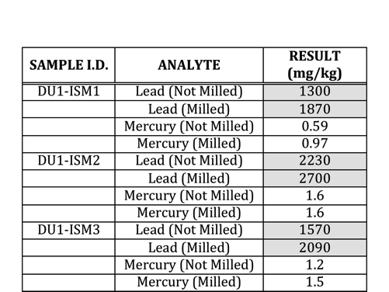
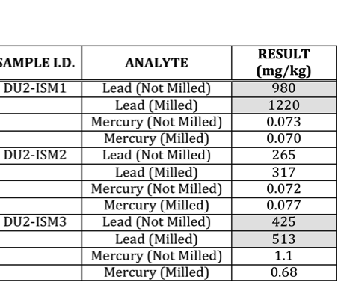
Results: ISM Data
DU1
DU2

Slide 35
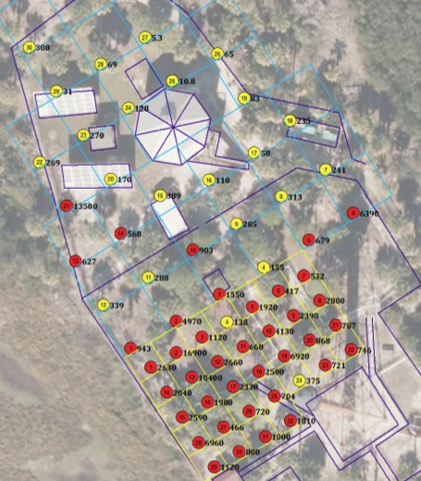
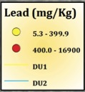


Results: Discrete Sample Data (0-6in)
Lead
Mercury

Slide 36

Results: Summary Discrete vs. ISM

Slide 37
Results: Data Evaluation Components
Identifying sources of error
Quantifying error
Data Evaluation
Interpreting error
Isolating sources of error
Notes:
Data evaluation can include several steps that we will discuss in the following slides

Slide 38
Results:
Identifying Sources of Error
Field
Laboratory
Number of increments
Increment collection
Field processing
Field splitting
DU size and shape
Lab processing
Subsampling
Extraction
Digestion
Analysis
Notes:
Error (Variability) – not “mistake”
Speaker Bullets – not comprehensive; theoretical sources of error discussed in Chapter 2 (Section 2.2) ISM controls these better than discrete
It is useful when evaluating data to consider the steps in the process where errors (variability) may have been introduced
If error is determined to be unacceptable in a given data set – one or more of these sources may be at fault

Slide 39
Summary
The lead concentrations among the ISM replicates was fairly variable for both DUs.
The process of milling did not reduce the variability between the ISM replicates.
Sample milling resulted in an increase lead concentration detected in the soil.
???

